Slide 1
Year 10 Mock Exam
English Language Section B
Revision

Slide 2
Language 2 Section B
You will be asked to plan and write 2 non-fiction pieces.
You must write for a specific audience, purpose and form.
Your audience might be the general public, teens and students your own age, or a particular person like a head teacher.
The purpose is to show you can describe, explain, advise, persuade and argue.
The form could be a letter, a newspaper or magazine article or a speech.
All non-fiction writing is made up of minimum 5 paragraph: introduction, 3 main body points and a conclusion.
You must revise the format and layout of a letter, article and speech.

Slide 3
Write a Minimum of 5 Paragraphs
All non-fiction writing is made up of minimum 5 paragraph:
introduction, 3 main body points and a conclusion.
You must write in Standard English.
You should use persuasive techniques.
Use the next slides to revise persuasive techniques and convention or ingredients of a formal letter, article, speech and persuasive writing.

Slide 4
Memorable Persuasive Techniques
Snappy opening or a ‘hook’ opening sentence
Anecdote –short story to make a point
Repetition, anaphora
List of 3, triplets
Personal pronouns, direct address
Facts, figures, data, statistics
Expert quotes
Emotive language and words
Rhetorical questions
Poetic language: similes, metaphors, rhyme
Counter argue some may think…however
Discourse markers firstly secondly thirdly
‘Call to action’ in your conclusion
Sub-heads and Bullet-points
A.F.O.R.E.S.T

Slide 5
Letter Writing
A letter must have the name and address of the recipient and sender (you), a standard way to address the recipient and a formal sign off.
Do not write out the full address. Simply use a text box to show the examiner you know what a letter looks like.
You address your recipient two ways – pick 1 to memorise:
1. To Whom it May Concern and Dear Sir / Madam = Yours Faithfully
2. Use their name e.g. Dear Mr Blogg / Dear Headteacher = Yours Sincerely
A formal letter in written in Standard English using persuasive techniques:
Introduction: explain why you are writing.
3 main body paragraphs (1 idea per paragraph: firstly, secondly, finally)
Conclusion. Explain what you hope to achieve. End with a call to action.

Slide 6
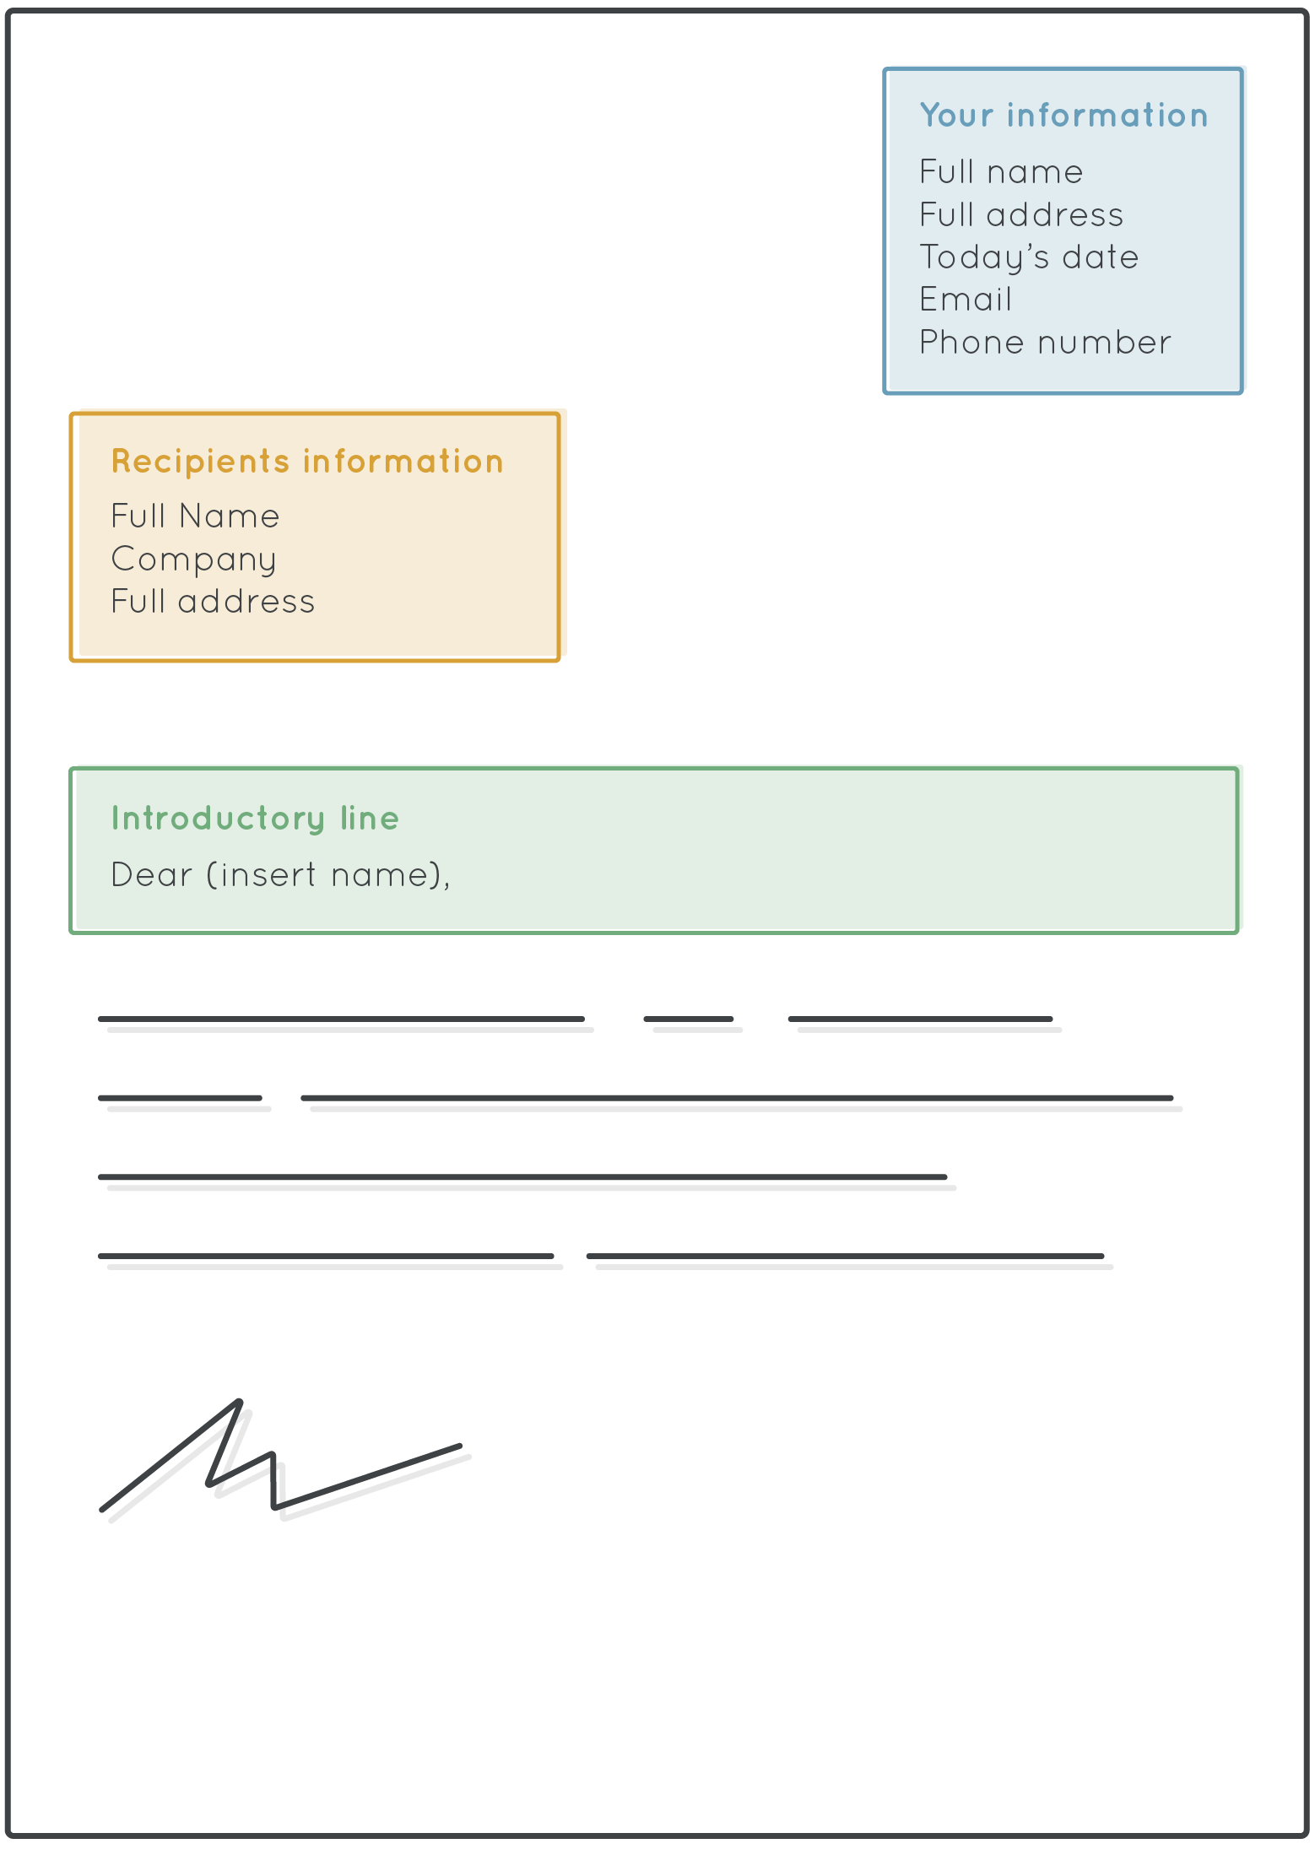

Slide 7
Newspaper or Magazine Article
An article will have a:
headline (title)
strapline (subtitle)
subheadings
bullet points / number list
Write minimum 5 paragraph using Standard English and persuasive techniques: introduction, 3 main body points and a conclusion.

Slide 8
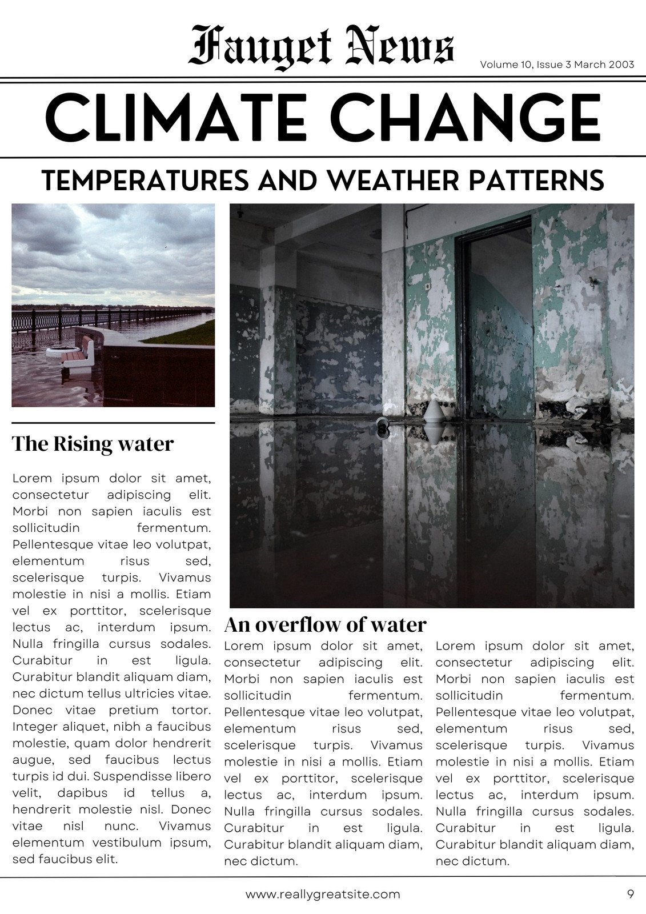

Slide 9
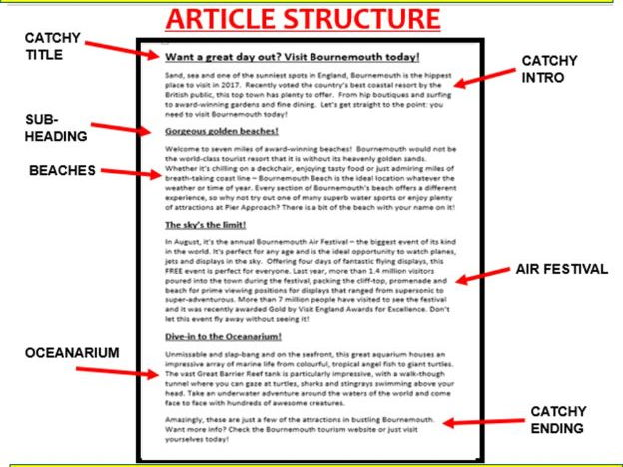

Slide 10
Persuasive Writing ‘Write what you think’ ‘give your views’ ’respond to this view’
This question means to explain, persuade, and give your opinion.
You may be asked to write a letter or a review or a report giving your view and opinions.
The examiner wants to see you can argue your case or ideas clearly and convincingly.
Stick to either for or against. Not both.
Do not present both views (like in RE)
Write minimum 5 paragraph using Standard English and persuasive techniques: introduction, 3 main body points and a conclusion.

Slide 12
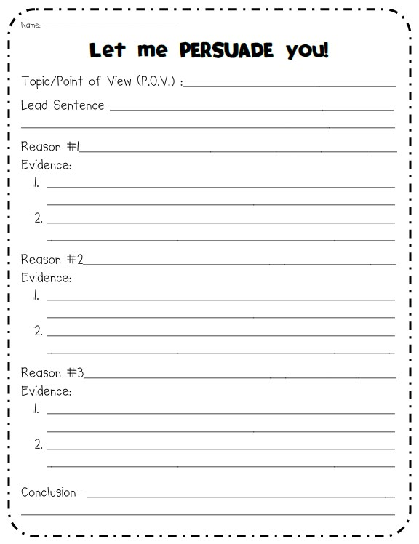

Slide 13
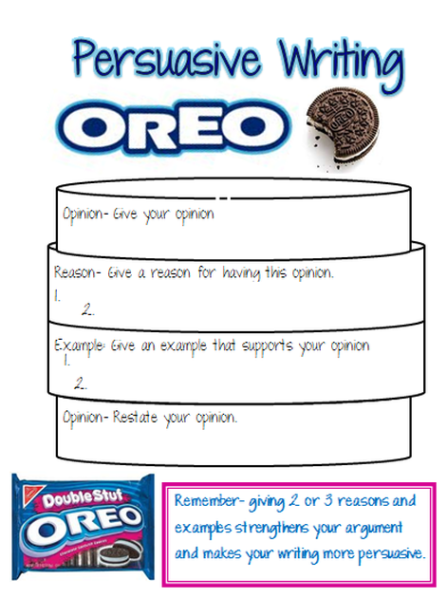

Slide 14
‘Give a talk’ – Speech Writing
‘Give a talk’ means speech writing.
Here you must showcase all the writing skills: explain, describe, persuade.
You should directly address your audience using personal pronouns.
Write minimum 5 paragraph using Standard English and persuasive techniques: introduction, 3 main body points and a conclusion.

Slide 15
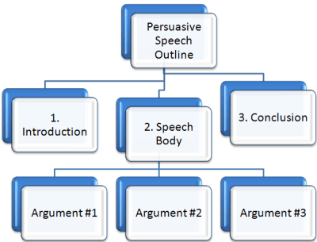

Slide 16
How to use this booklet:
Practice the past exam paper questions under timed conditions:
5 mins planning
25 mins writing
5 mins proof-reading, check SPaG
write about 1 ½ - 2 pages
use black pen
switch to green pen after 30 mins

Slide 17
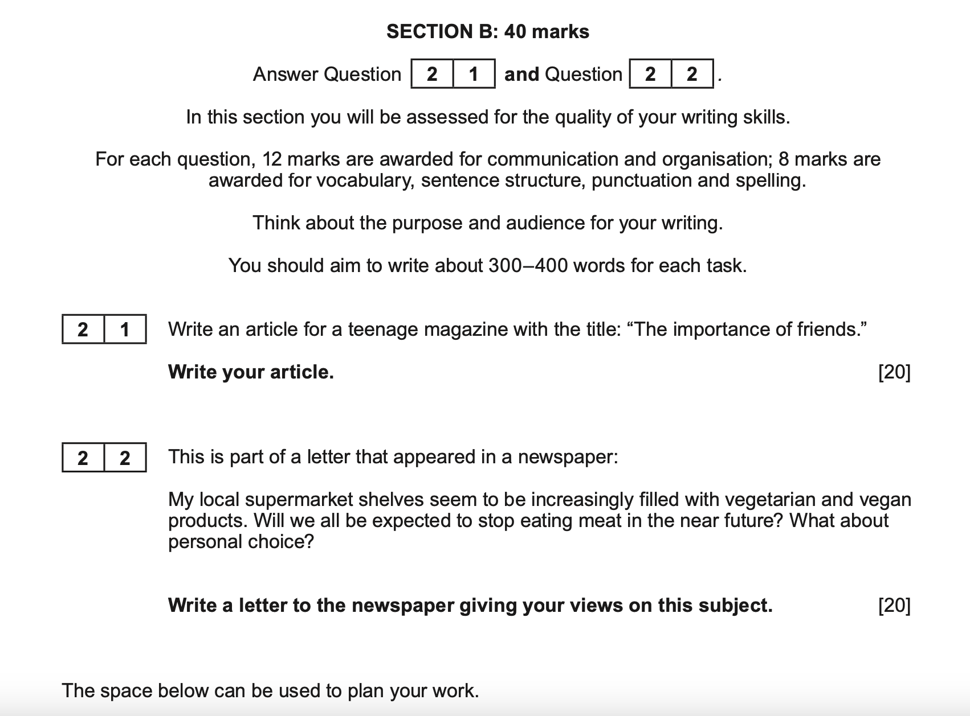

Slide 18
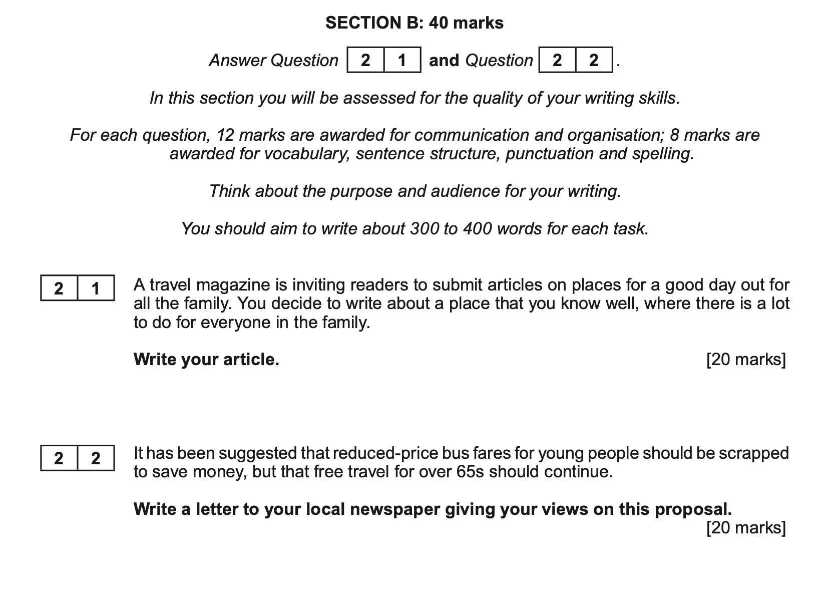

Slide 19
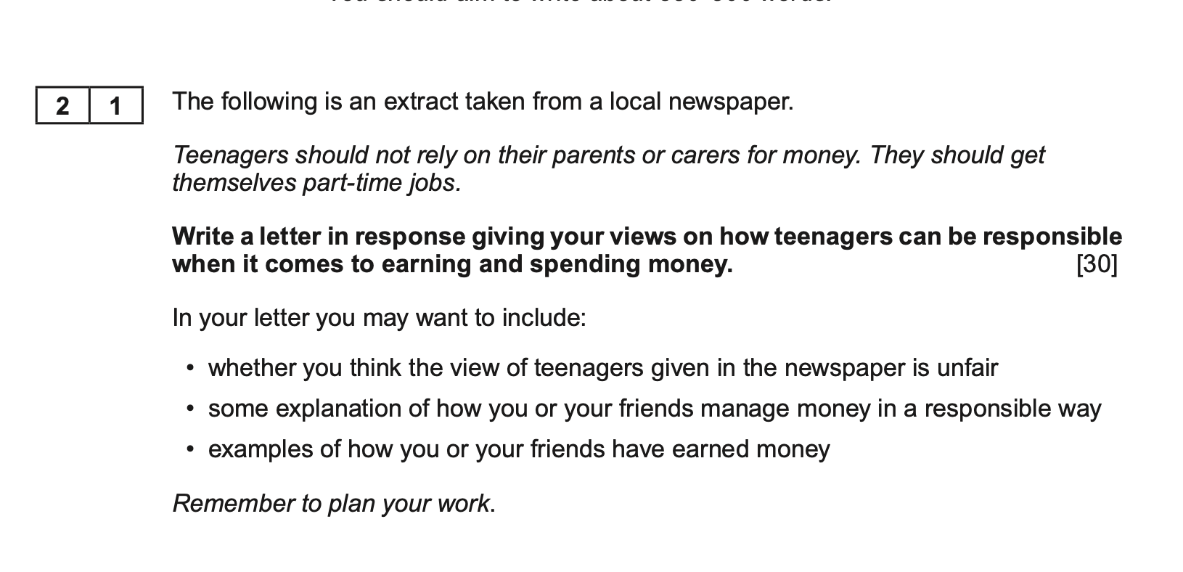

Slide 20
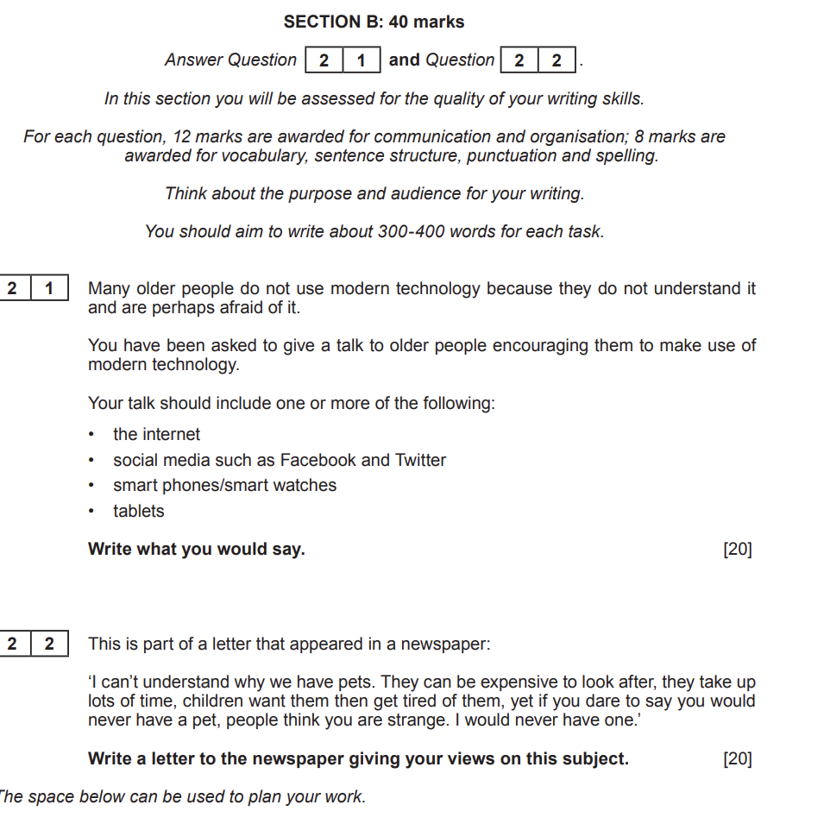

Slide 21
